Slide 1
Gemini Updates
Arjun Ray Undergraduate Research Assistant II raya@frib.msu.edu
🡪 The Joint DNP/JPS workshop “Fragment Separation at RIBF and FRIB and Rare Isotope Production Mechanisms”

Slide 2
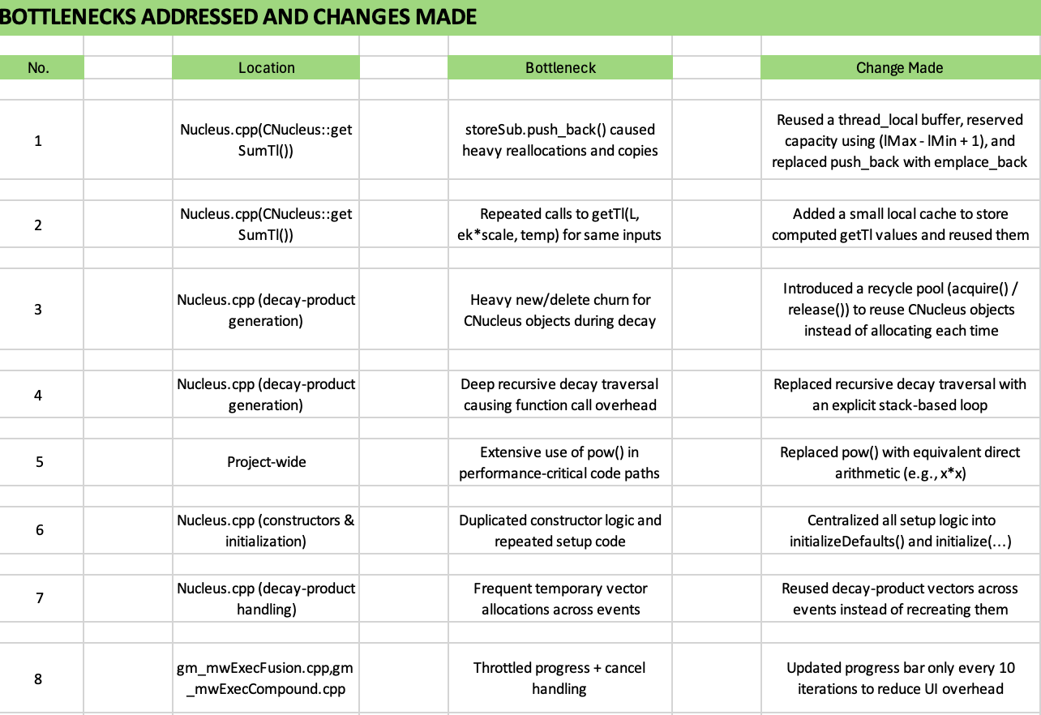
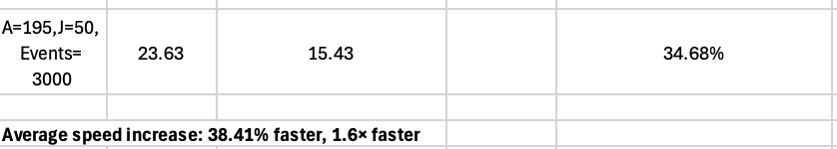
Optimization
– Gemini profiling to search for bottleneck points
– Gemini optimization at bottleneck points and more to result in Gemini being ~1.6x faster
A. Ray, Slide 2

Slide 3
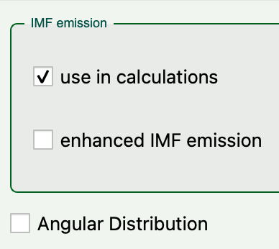
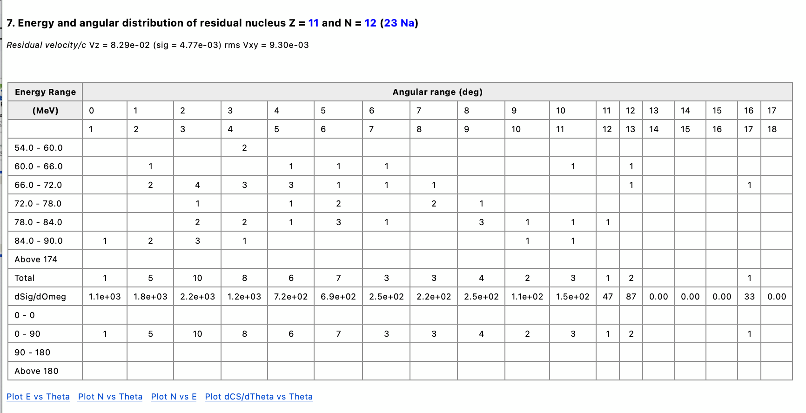
Angular Distribution Table
Checkbox to display tables and plots in a new window
– Implemented PACE style angular distribution tables for Gemini
4 types of plots for each table

Slide 4
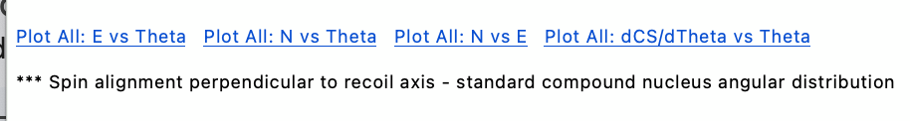
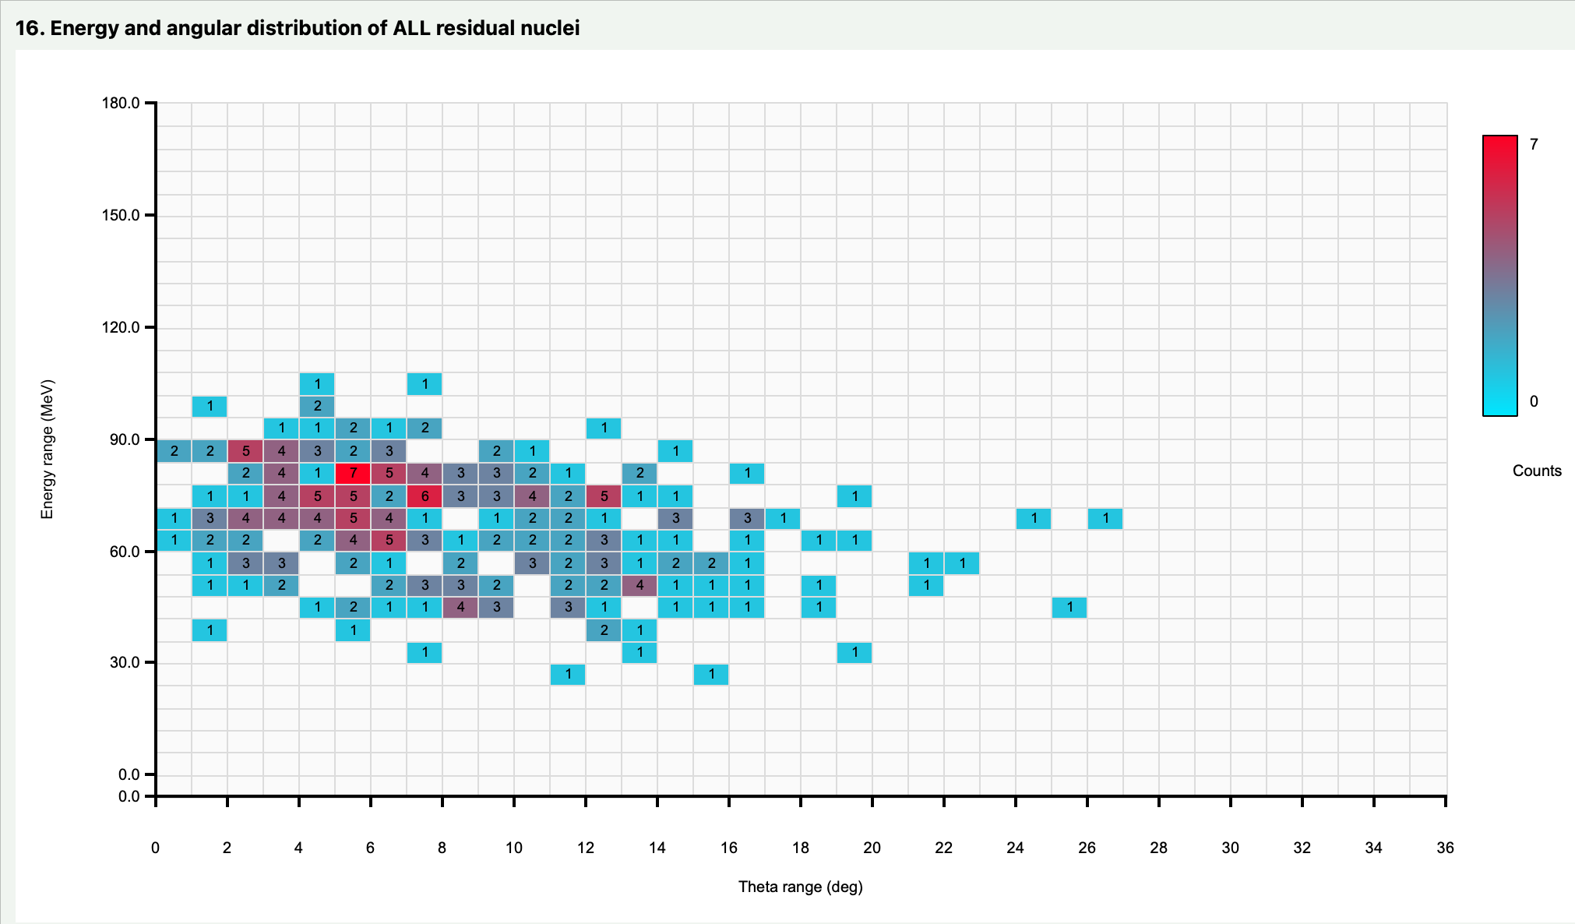
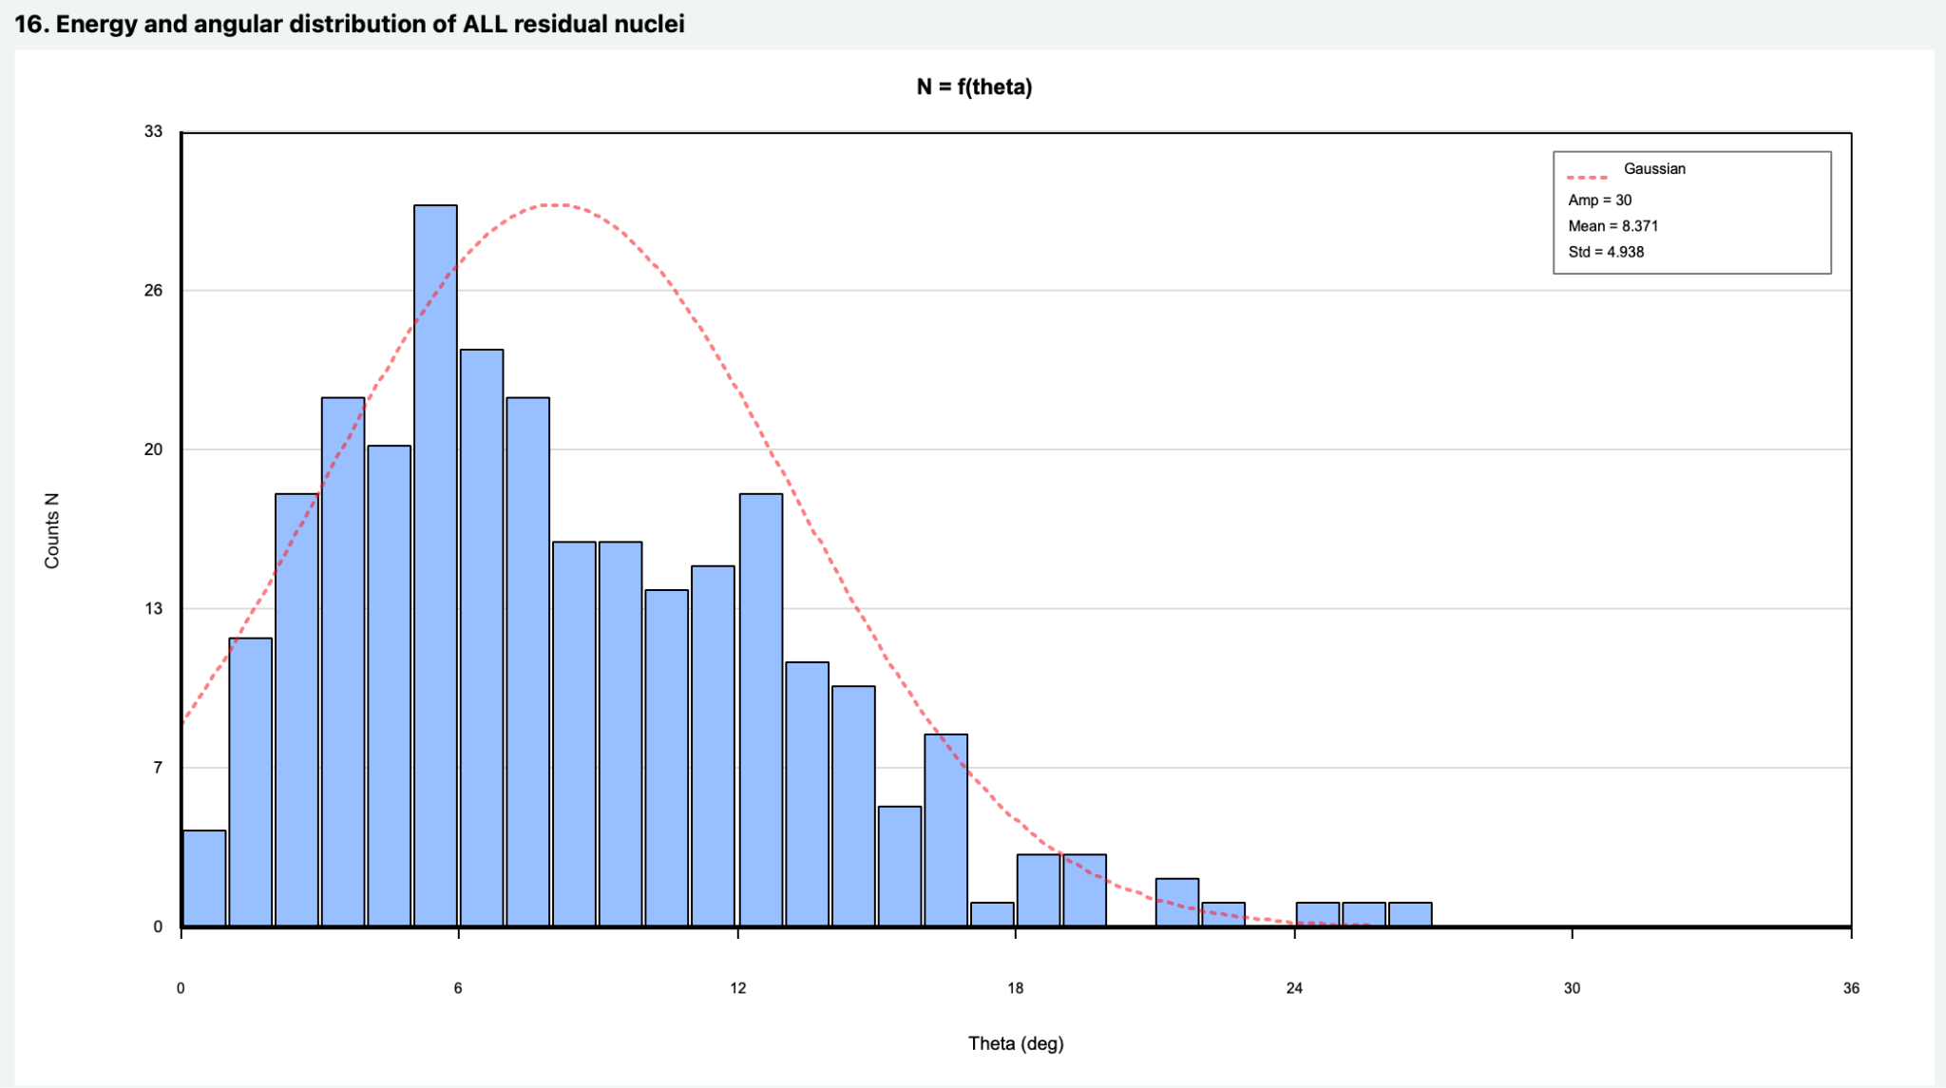
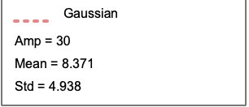
Plots
“Plot All” option for each type of plot to display plots for all tables
Gaussian distribution for all 1D plots with N(count)
2D E vs Theta Plot example
1D plot example
A. Ray, Slide 4

